Slide 1
Elementary Statistics: Picturing The World
Sixth Edition
Chapter 2
Descriptive Statistics
Copyright © 2015, 2012, 2009 Pearson Education, Inc. All Rights Reserved

Slide 2
Chapter Outline
2.1 Frequency Distributions and Their Graphs
2.2 More Graphs and Displays
2.3 Measures of Central Tendency
2.4 Measures of Variation
2.5 Measures of Position

Slide 3
Section 2.3
Measures of Central Tendency

Slide 4
Section 2.3 Objectives
How to find the mean, median, and mode of a population and of a sample
How to find the weighted mean of a data set and the mean of a frequency distribution
How to describe the shape of a distribution as symmetric, uniform, or skewed and how to compare the mean and median for each

Slide 5
Measures of Central Tendency
Measure of central tendency
A value that represents a typical, or central, entry of a data set.
Most common measures of central tendency:
  Mean
  Median
  Mode

Slide 6
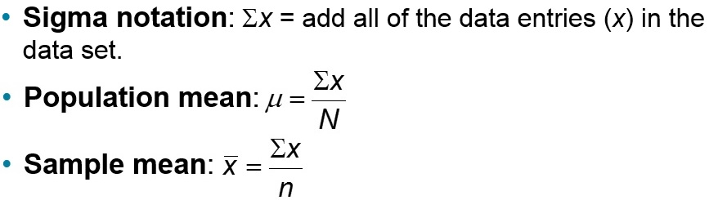
Measure of Central Tendency: Mean
Mean (average)
The sum of all the data entries divided by the number of entries.

Slide 7
Example: Finding a Sample Mean (1 of 2)
The prices (in dollars) for a sample of roundtrip flights from Chicago, Illinois to Cancun, Mexico are listed. What is the mean price of the flights?
872 432 397 427 388 782 397

Slide 8
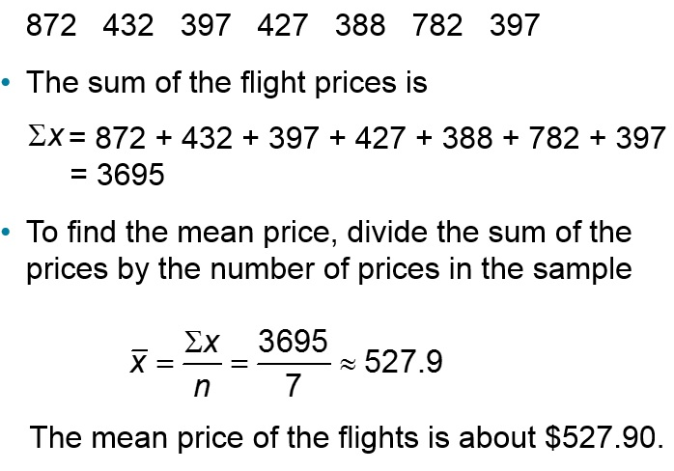
Example: Finding a Sample Mean (2 of 2)

Slide 9
Measure of Central Tendency: Median
Median
The value that lies in the middle of the data when the data set is ordered.
Measures the center of an ordered data set by dividing it into two equal parts.
If the data set has an
  odd number of entries: median is the middle data entry.
  even number of entries: median is the mean of the two middle data entries.

Slide 10
Example 1: Finding the Median (1 of 2)
The prices (in dollars) for a sample of roundtrip flights from Chicago, Illinois to Cancun, Mexico are listed. Find the median of the flight prices.
872 432 397 427 388 782 397

Slide 11
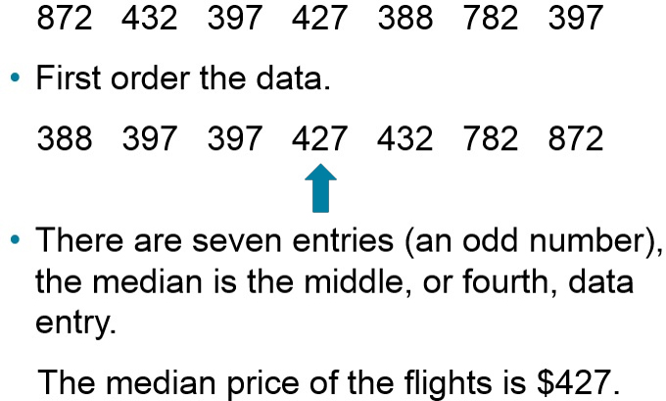
Example 1: Finding the Median (2 of 2)

Slide 12
Example 2: Finding the Median (1 of 2)
The flight priced at $432 is no longer available. What is the median price of the remaining flights?
872 397 427 388 782 397

Slide 13
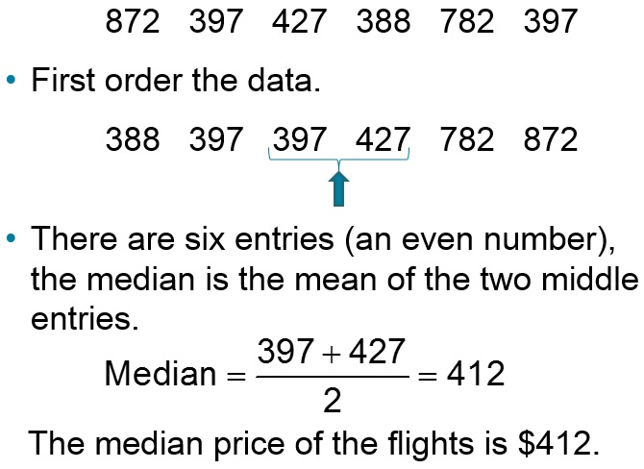
Example 2: Finding the Median (2 of 2)

Slide 14
Measure of Central Tendency: Mode
Mode
The data entry that occurs with the greatest frequency.
If no entry is repeated the data set has no mode.
If two entries occur with the same greatest frequency, each entry is a mode (bimodal).

Slide 15
Example 1: Finding the Mode (1 of 2)
The prices (in dollars) for a sample of roundtrip flights from Chicago, Illinois to Cancun, Mexico are listed. Find the mode of the flight prices.
872 432 397 427 388 782 397

Slide 16
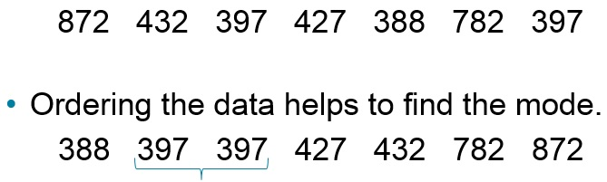
Example 1: Finding the Mode (2 of 2)
The entry of 397 occurs twice, whereas the other data entries occur only once.
The mode of the flight prices is $397.

Slide 17
Example 2: Finding the Mode (1 of 2)
At a political debate a sample of audience members was asked to name the political party to which they belong. Their responses are shown in the table. What is the mode of the responses?
Political Party | Frequency, f
Democrat | 34
Republican | 56
Other | 21
Did not respond | 9

Slide 18
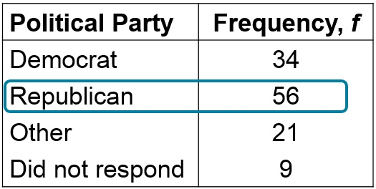
Example 2: Finding the Mode (2 of 2)
The mode is Republican (the response occurring with the greatest frequency). In this sample there were more Republicans than people of any other single affiliation.

Slide 19
Comparing the Mean, Median, and Mode
All three measures describe a typical entry of a data set.
Advantage of using the mean:
  The mean is a reliable measure because it takes into account every entry of a data set.
Disadvantage of using the mean:
  Greatly affected by outliers (a data entry that is far removed from the other entries in the data set).

Slide 20
Example: Comparing the Mean, Median, and Mode (1 of 4)
Find the mean, median, and mode of the sample ages of a class shown. Which measure of central tendency best describes a typical entry of this data set? Are there any outliers?
Ages in a class
20 | 20 | 20 | 20 | 20 | 20 | 21
21 | 21 | 21 | 22 | 22 | 22 | 23
23 | 23 | 23 | 24 | 24 | 65 | blank

Slide 21
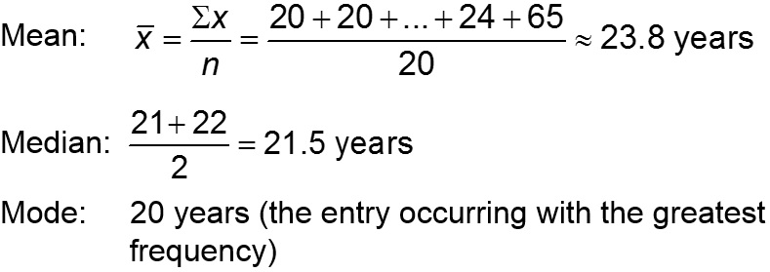
Example: Comparing the Mean, Median, and Mode (2 of 4)
Ages in a class
20 | 20 | 20 | 20 | 20 | 20 | 21
21 | 21 | 21 | 22 | 22 | 22 | 23
23 | 23 | 23 | 24 | 24 | 65 | blank

Slide 22
Example: Comparing the Mean, Median, and Mode (3 of 4)
Mean ≈ 23.8 years Median = 21.5 years Mode = 20 years
The mean takes every entry into account, but is influenced by the outlier of 65.
The median also takes every entry into account, and it is not affected by the outlier.
In this case the mode exists, but it doesn't appear to represent a typical entry.

Slide 23
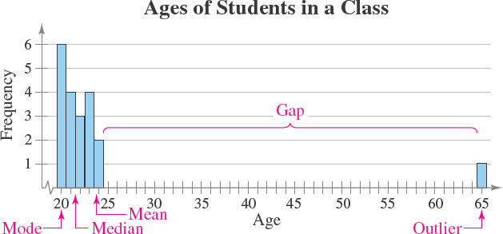
Example: Comparing the Mean, Median, and Mode (4 of 4)
Sometimes a graphical comparison can help you decide which measure of central tendency best represents a data set.

Slide 24
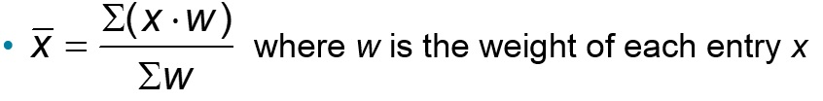
Weighted Mean
Weighted Mean
The mean of a data set whose entries have varying weights.

Slide 25
Example: Finding a Weighted Mean (1 of 2)
You are taking a class in which your grade is determined from five sources: 50% from your test mean, 15% from your midterm, 20% from your final exam, 10% from your computer lab work, and 5% from your homework. Your scores are 86 (test mean), 96 (midterm), 82 (final exam), 98 (computer lab), and 100 (homework). What is the weighted mean of your scores? If the minimum average for an A is 90, did you get an A?

Slide 26
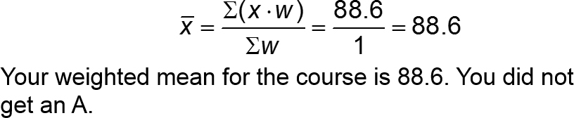
Example: Finding a Weighted Mean (2 of 2)
Source | Score, x | Weight, w | X ∙ w
Test Mean | 86 | 0.50 | 86(0.50) = 43.0
Midterm | 96 | 0.15 | 96(0.15) = 14.4
Final Exam | 82 | 0.20 | 82(0.20) = 16.4
Computer Lab | 98 | 0.10 | 98(0.10) = 9.8
Homework | 100 | 0.05 | 100(0.05) = 5.0
blank | blank | Σw = 1 | Σ(x ∙ w) = 88.6

Slide 27
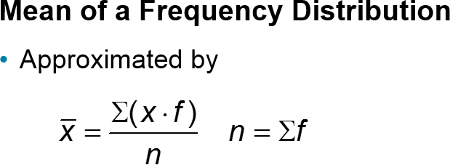
Mean of Grouped Data
where x and f are the midpoints and frequencies of a class, respectively

Slide 28
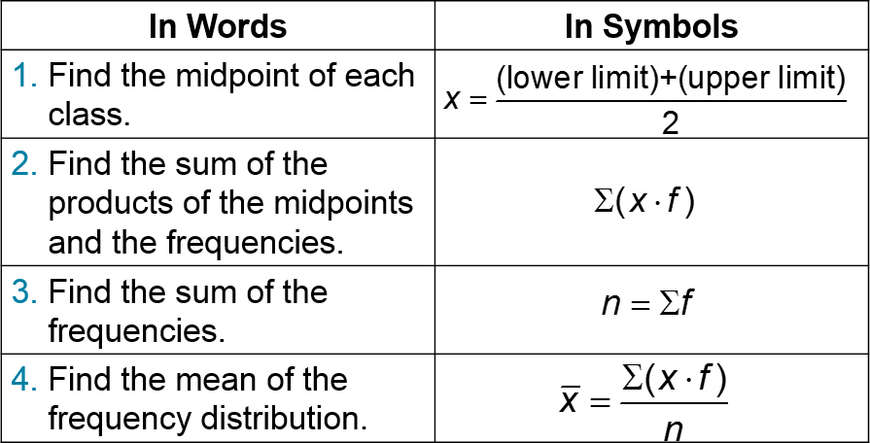
Finding the Mean of a Frequency Distribution

Slide 29
Example: Find the Mean of a Frequency Distribution (1 of 2)
Use the frequency distribution to approximate the mean number of minutes that a sample of Internet subscribers spent online during their most recent session.
Class | Midpoint | Frequency, f
7 – 18 | 12.5 | 6
19 – 30 | 24.5 | 10
31 – 42 | 36.5 | 13
43 – 54 | 48.5 | 8
55 – 66 | 60.5 | 5
67 – 78 | 72.5 | 6
79 – 90 | 84.5 | 2

Slide 30

Example: Find the Mean of a Frequency Distribution (2 of 2)
Class | Midpoint, x | Frequency, f | (x ∙ f)
7 – 18 | 12.5 | 6 | 12.5∙6 = 75.0
19 – 30 | 24.5 | 10 | 24.5∙10 = 245.0
31 – 42 | 36.5 | 13 | 36.5∙13 = 474.5
43 – 54 | 48.5 | 8 | 48.5∙8 = 388.0
55 – 66 | 60.5 | 5 | 60.5∙5 = 302.5
67 – 78 | 72.5 | 6 | 72.5∙6 = 435.0
79 – 90 | 84.5 | 2 | 84.5∙2 = 169.0
blank | blank | n = 50 | Σ(x ∙ f) = 2089.0

Slide 31
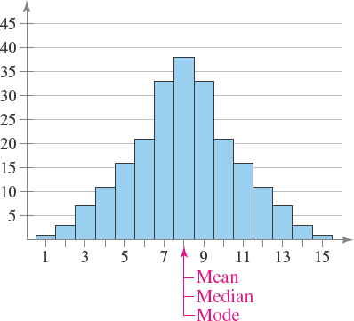
The Shape of Distributions (1 of 4)
Symmetric Distribution
A vertical line can be drawn through the middle of a graph of the distribution and the resulting halves are approximately mirror images.

Slide 32
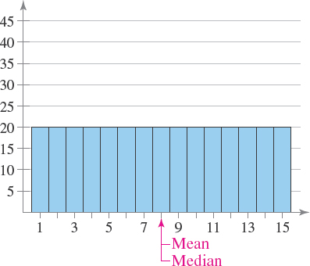
The Shape of Distributions (2 of 4)
Uniform Distribution (rectangular)
All entries or classes in the distribution have equal or approximately equal frequencies.
Symmetric.

Slide 33
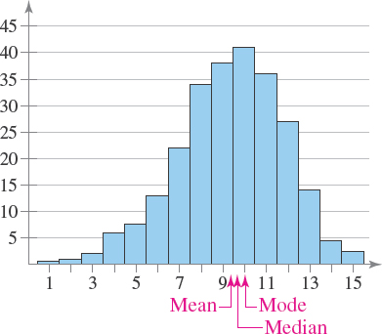
The Shape of Distributions (3 of 4)
Skewed Left Distribution (negatively skewed)
The “tail” of the graph elongates more to the left.
The mean is to the left of the median.

Slide 34
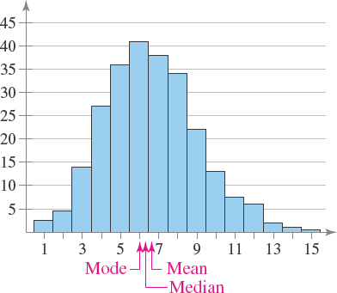
The Shape of Distributions (4 of 4)
Skewed Right Distribution (positively skewed)
The “tail” of the graph elongates more to the right.
The mean is to the right of the median.

Slide 35
Section 2.3 Summary
Found the mean, median, and mode of a population and of a sample
Found the weighted mean of a data set and the mean of a frequency distribution
Described the shape of a distribution as symmetric, uniform, or skewed and compared the mean and median for each

