Slide 1
Elementary Statistics: Picturing The World
Sixth Edition
Chapter 5
Normal Probability Distributions
Copyright © 2015, 2012, 2009 Pearson Education, Inc. All Rights Reserved

Slide 2
Chapter Outline
5.1 Introduction to Normal Distributions and the Standard Normal Distribution
5.2 Normal Distributions: Finding Probabilities
5.3 Normal Distributions: Finding Values
5.4 Sampling Distributions and the Central Limit Theorem
5.5 Normal Approximations to Binomial Distributions

Slide 3
Section 5.5
Normal Approximations to Binomial Distributions

Slide 4
Section 5.5 Objectives
How to determine when the normal distribution can approximate the binomial distribution
How to find the correction for continuity
How to use the normal distribution to approximate binomial probabilities

Slide 5
Normal Approximation to a Binomial (1 of 3)
The normal distribution is used to approximate the binomial distribution when it would be impractical to use the binomial distribution to find a probability.
Let n represent the number of independent trials, p is the probability of success in a single trial, and q is the probability of failure in a single trial.

Slide 6

Normal Approximation to a Binomial (2 of 3)
Normal Approximation to a Binomial Distribution
If np ≥ 5 and nq ≥ 5, then the binomial random variable x is approximately normally distributed with

Slide 7
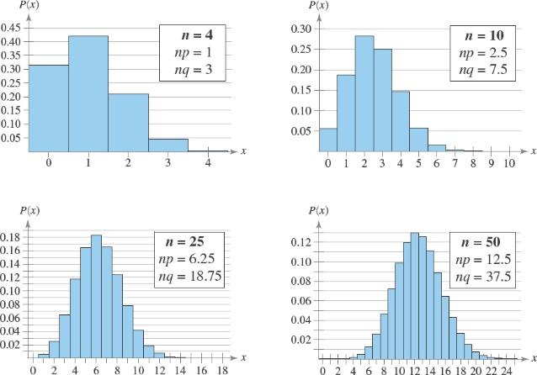
Normal Approximation to a Binomial (3 of 3)
Binomial distribution: p = 0.25
As n increases the histogram approaches a normal curve.

Slide 8
Example 1: Approximating the Binomial (1 of 2)
Decide whether you can use the normal distribution to approximate x, the number of people who reply yes. If you can, find the mean and standard deviation.
Sixty-two percent of adults in the U.S. have an HDTV in their homes. You randomly select 45 adults in the U.S. and ask them if they have an HDTV in their homes.

Slide 9
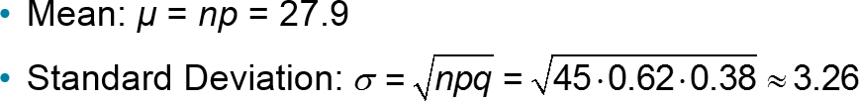
Example 1: Approximating the Binomial (2 of 2)
Solution
You can use the normal approximation
  n = 45, p = 0.62, q = 0.38
  np = (45)(0.62) = 27.9
  nq = (45)(0.38) = 17.1

Slide 10
Example 2: Approximating the Binomial (1 of 2)
Decide whether you can use the normal distribution to approximate x, the number of people who reply yes. If you can find, find the mean and standard deviation.
Twelve percent of adults in the U.S. who do not have an HDTV in their home are planning to purchase one in the next two years. You randomly select 30 adults in the U.S. who do not have an HDTV and ask them if they are planning to purchase one in the next two years.

Slide 11
Example 2: Approximating the Binomial (2 of 2)
Solution
You cannot use the normal approximation
  n = 30, p = 0.12, q = 0.88
  np = (30)(0.12) = 3.6
  nq = (30)(0.88) = 26.4
Because np < 5, you cannot use the normal distribution to approximate the distribution of x.

Slide 12
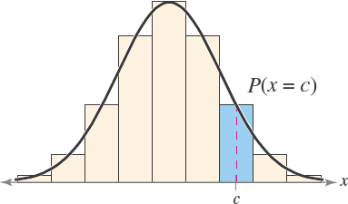
Correction for Continuity (1 of 2)
The binomial distribution is discrete and can be represented by a probability histogram.
To calculate exact binomial probabilities, the binomial formula is used for each value of x and the results are added.
Geometrically this corresponds to adding the areas of bars in the probability histogram.

Slide 13
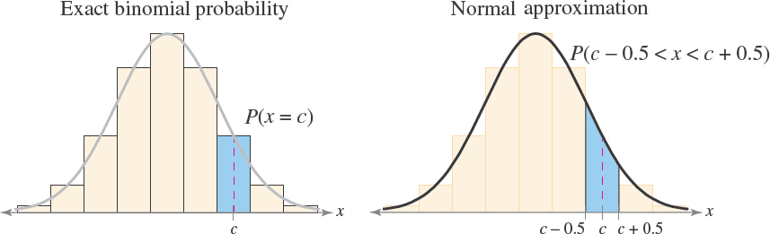
Correction for Continuity (2 of 2)
When you use a continuous normal distribution to approximate a binomial probability, you need to move 0.5 unit to the left and right of the midpoint to include all possible x-values in the interval (correction for continuity).

Slide 14
Example 1: Using a Correction for Continuity
Use a correction for continuity to convert the binomial intervals to a normal distribution interval.
The probability of getting between 270 and 310 successes, inclusive.
Solution
The discrete midpoint values are 270, 271, …, 310.
The corresponding interval for the continuous normal distribution is 269.5 < x < 310.5. The normal distribution probability is P(269.5 < x < 310.5).

Slide 15
Example 2: Using a Correction for Continuity
Use a correction for continuity to convert the binomial intervals to a normal distribution interval.
The probability of getting at least 158 successes.
Solution
The discrete midpoint values are 158, 159, 160, ….
The corresponding interval for the continuous normal distribution is x > 157.5. The normal distribution probability is P(x > 157.5).

Slide 16
Example 3: Using a Correction for Continuity
Use a correction for continuity to convert the binomial intervals to a normal distribution interval.
The probability of getting less than 63 successes.
Solution
The discrete midpoint values are …,60, 61, 62.
The corresponding interval for the continuous normal distribution is x < 62.5. The normal distribution probability is P(x < 62.5).

Slide 17
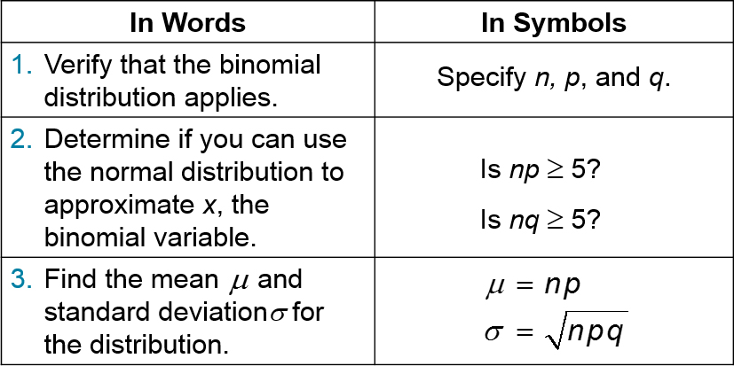
Using the Normal Distribution to Approximate Binomial Probabilities (1 of 2)

Slide 18
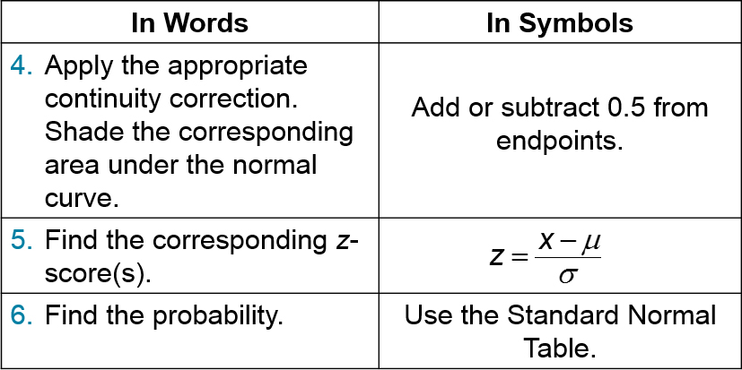
Using the Normal Distribution to Approximate Binomial Probabilities (2 of 2)

Slide 19
Example 1: Approximating a Binomial Probability (1 of 2)
Sixty-two percent of adults in the U.S. have an HDTV in their home. You randomly select 45 adults in the U.S. and ask them if they have an HDTV in their home. What is the probability that fewer than 20 of them respond yes? (Source: Opinion Research Corporation)
Solution
Can use the normal approximation

Slide 20
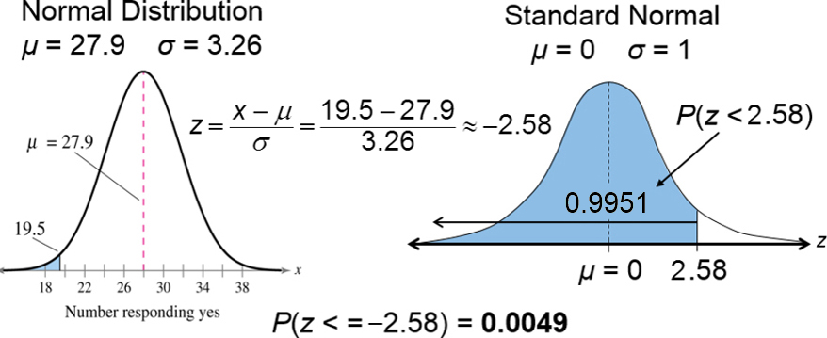
Example 1: Approximating a Binomial Probability (2 of 2)
Apply the continuity correction:
Fewer than 20 (…17, 18, 19) corresponds to the continuous normal distribution interval x = 19.5

Slide 21
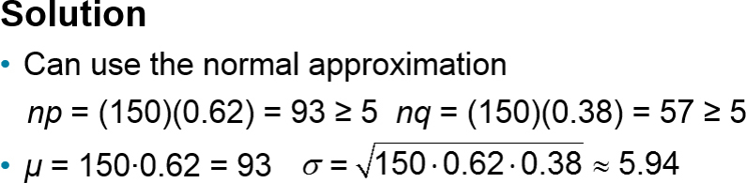
Example 2: Approximating a Binomial Probability (1 of 2)
A survey reports that 62% of Internet users use Windows® Internet Explorer ® as their browser. You randomly select 150 Internet users and ask each whether they use Internet Explorer as their browser. What is the probability that exactly 96 will say yes? (Source: Net Applications)

Slide 22
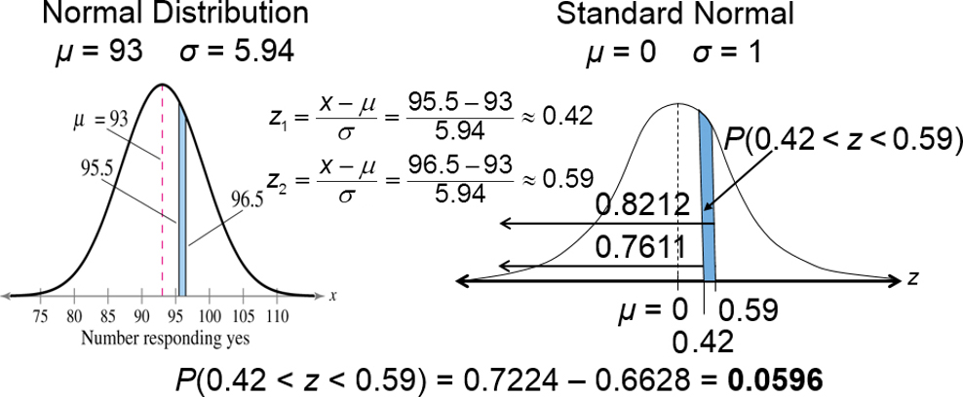
Example 2: Approximating a Binomial Probability (2 of 2)
Apply the continuity correction:
Exactly 96 corresponds to the continuous normal distribution interval 95.5 < x < 96.5

Slide 23
Section 5.5 Summary
Determined when the normal distribution can approximate the binomial distribution
Found the correction for continuity
Used the normal distribution to approximate binomial probabilities

